Slide 1
Trivia Quiz Bowl
Ivan baydov, Diana Alkajo, and Elijah Barchue

Slide 2
Website Goals
Education – This website should serve an educational purpose by promoting learning and increasing users' general knowledge through wide range of topics and questions.
Entertainment – This website should also offer fun and engaging questions and will challenge users’ knowledge and encourage friendly competition.
Competition – This website should provide a platform for users’ and teams to compete against each other in a fair and engaging manner.
Feedback and Improvement – it should also gather feedback and continuously improve users’ experience.
Varied content – offered a diverse range of trivia questions across various categories and difficulty levels .

Slide 3
Product Backlog
Content updates – keep up with recent information for best users’ experience.
Mobile Responsiveness – optimized for various devices and screen sizes so users can use on the go.
Community Building – features like forums, chat, or user engagement initiatives.
Infrastructure and Hosting – should allow users to manage the website the way they prefer.

Slide 4
Programming Language & Tool
For our project, we are creating the website on Wix, which has the Velo developing platform.
The Velo by Wix platform uses a variant of Javascript, which is the programming language that we are fully using to work on this project.
We are using Postman which helps us view the contents/data of the API link that we used to get our questions. It can also be used to create API’s as well.
The Open Trivia Database is a website that we are using that allows us to select any category, select the difficulty of the questions, choosing the number of questions, and choosing multiple choice or true/false questions. Once selected it would generate an API link which we can use Postman to view each Variable/Key that contains information to pull and use into our Wix page.

Slide 5
Schedule
Because of the change in our project, for the week after the presentations, we were brainstorming ideas and planning on how to execute them.
After coming up with the idea, we started working on it immediately. We started with creating an outline for the website and how everything will work for each category.
Now, we are working on the code for the website and to make sure there are no errors with any links or elements. Next, we will be working on the design of the website and making sure that it is neat and organized.
The work for this project is divided equally so that each team member gets the same amount of work and that all of our ideas are executed.

Slide 6
Challanges
Our biggest challenge was changing our whole project Idea. The way we handled this issue was create a big list of possible idea’s we can accomplish and vote for each Idea from 1-4. The Trivia Quiz Bowl was the winner of what our team was most comfortable working on this project.
Understanding how to use Wix. Our group mostly looked through the internet to find quick ways to add, remove, and move parts of the webpage to look it more user friendly and prepare our webpage before the overall coding begins.
One Challenge that will soon show up is the overall coding for this website. We have not started any coding yet, but have completed the UI we wished to complete in this time frame. Once the coding begins, we will have to learn Wix’s new programing language which is named Velo. Velo support’s JavaScript and it also supports Velo API which allows us to use a database that works with Wix to collet user data such as a user inputting there answer choices to questions and matching if it match’s the string value of the question displayed to count the questions as right or wrong. By searching up on google and YouTube on how to use Velo’s syntax will allow us to learn how to code in velo which would allow us to complete our project.

Slide 7
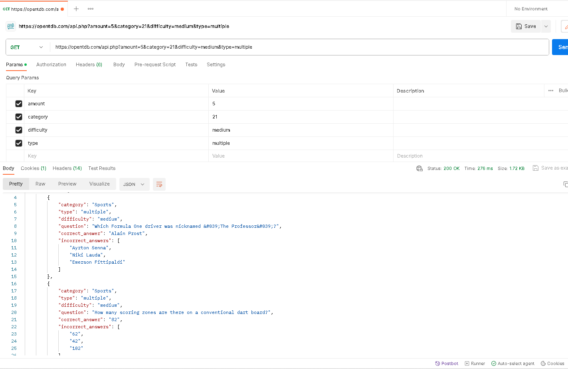
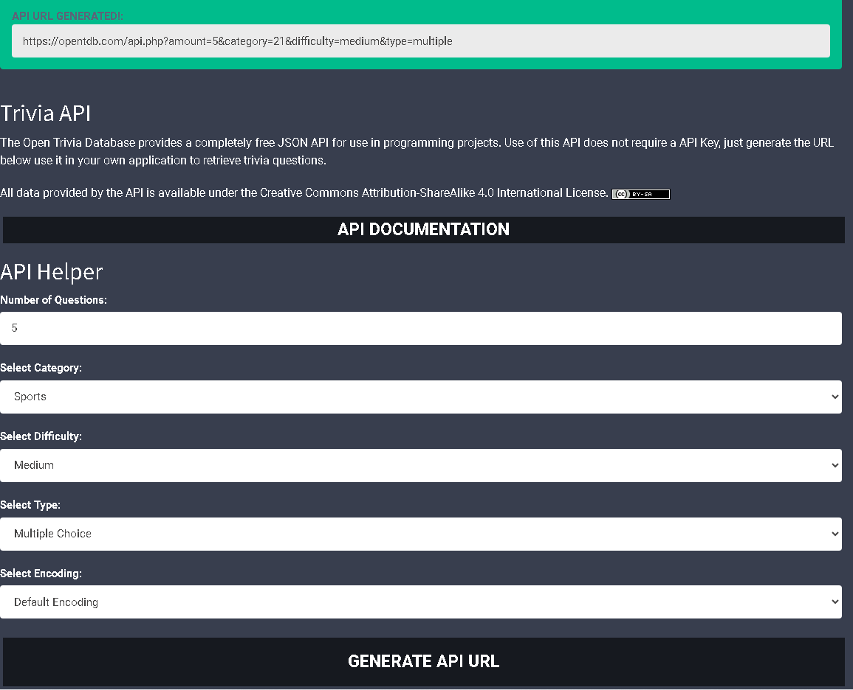
Demo

